Slide 1
Problem Statement
To study the ECG Signal using various Signal Processing Algorithms and later use a suitable Deep Learning Model to build a disease classifier based on the inputs received in the form of ECG Signal.
In our case, we would try to classify the ECG Signals as that of Arrythmia(ARR), Congestive Heart Failure(CHF) or Normal Sinus Rhythm(NSR).

Slide 2
REQUIREMENTS
MATLAB
WAVELET TRANSFORM – ANALYTIC MORLET
ALEXNET – FOR OUR DEEP LEARNING MODEL
PHYSIONET - FOR GETTING DATA FOR TRAINING MODEL

Slide 3
ECG SIGNAL AND HUMAN HEART
ECG Signal has PQRST Complex.
Each part of the wave corresponds to some movement of a section of heart muscles.
For the sake of our analysis, study of QRS Peak is most important.

Slide 4
BASIC IDEA OF ECG SIGNALS FOR ARR,CHF AND NSR
ARR – Arrythmia is a situation where heartbeat becomes irregular. There will be uneven gap between different pairs of QRS peaks.
CHF – This situation occurs when the heart becomes too weak or too stiff to pump blood.
NSR – This is the case of a normal functioning human heart.

Slide 5
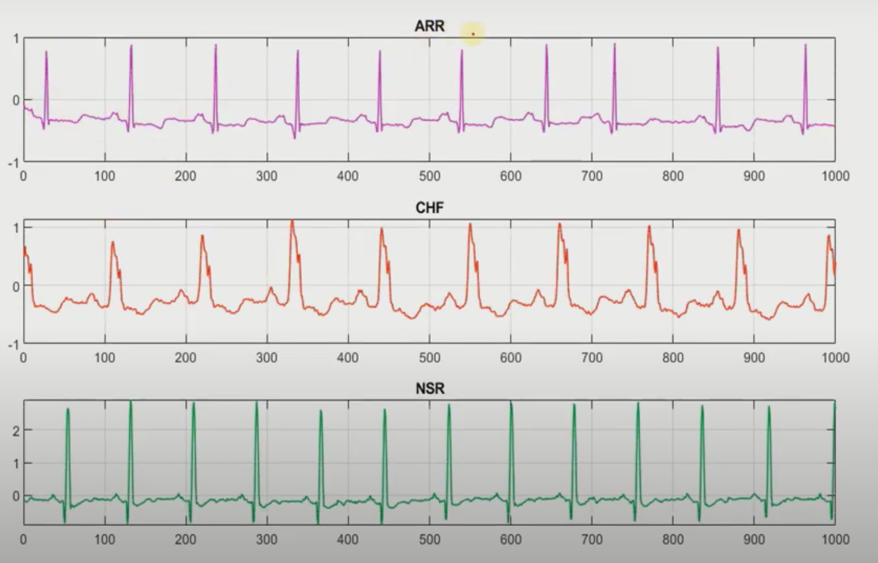

Slide 6
WAVELET TRANSFORM
Wavelet transform provides information about both frequency as well as time aspects about the wave.
Wavelet is a part of a wave with an average value 0.
It forms a scalogram, which is a 2D image which carries information in both time domain and frequency domain.
Scalogram consists of plot of 2 coefficients – a and b, where a (Dilation parameter) carries the information about frequency and b(Translation parameter) carries the information about time.
It can be of 2 types : Continuous and Discrete
For our analysis, we are using a type of continuous wavelet transform known as Analytic Morlet Transform.

Slide 7
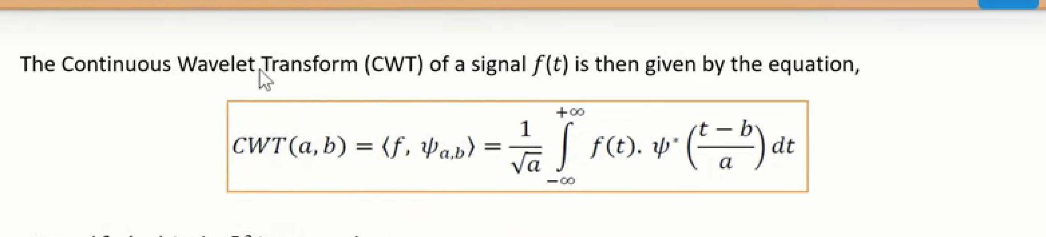

Slide 8
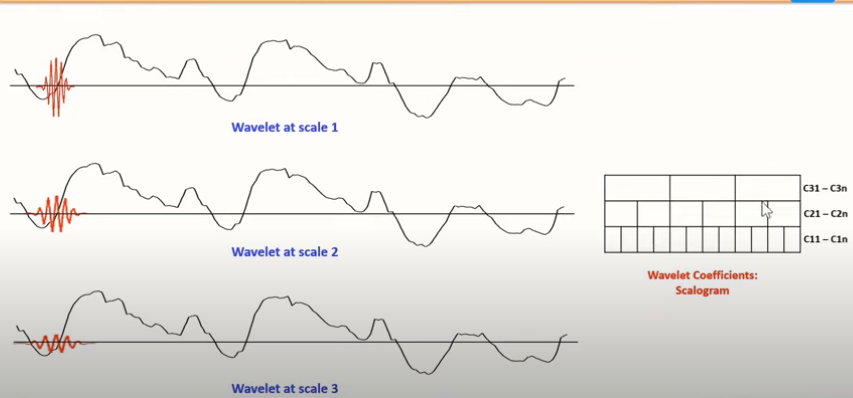

Slide 9
AlexNet
In our project we have used AlexNet as our DEEP LEARNING MODEL for making prediction.
It is a pre-trained model with the capability of classifying upto 1000 different objects
It has upto 60 million parameters and to deal with the problem of overfitting, it uses drop-out.
It has 5 convolution layer, 3 fully connected layer, including 1 softmax layer.
It takes input in the form of a 227 X 227 image.

Slide 10
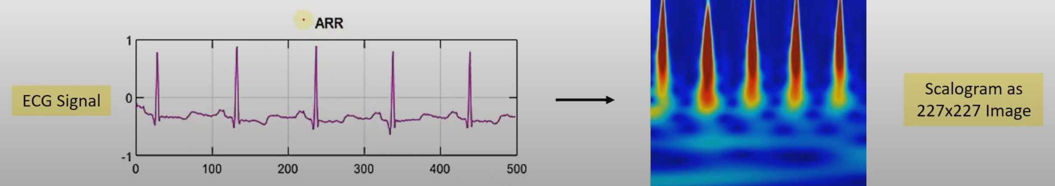

Slide 11
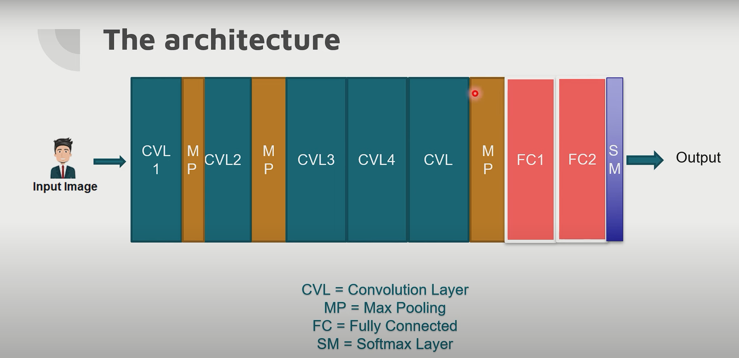

Slide 12
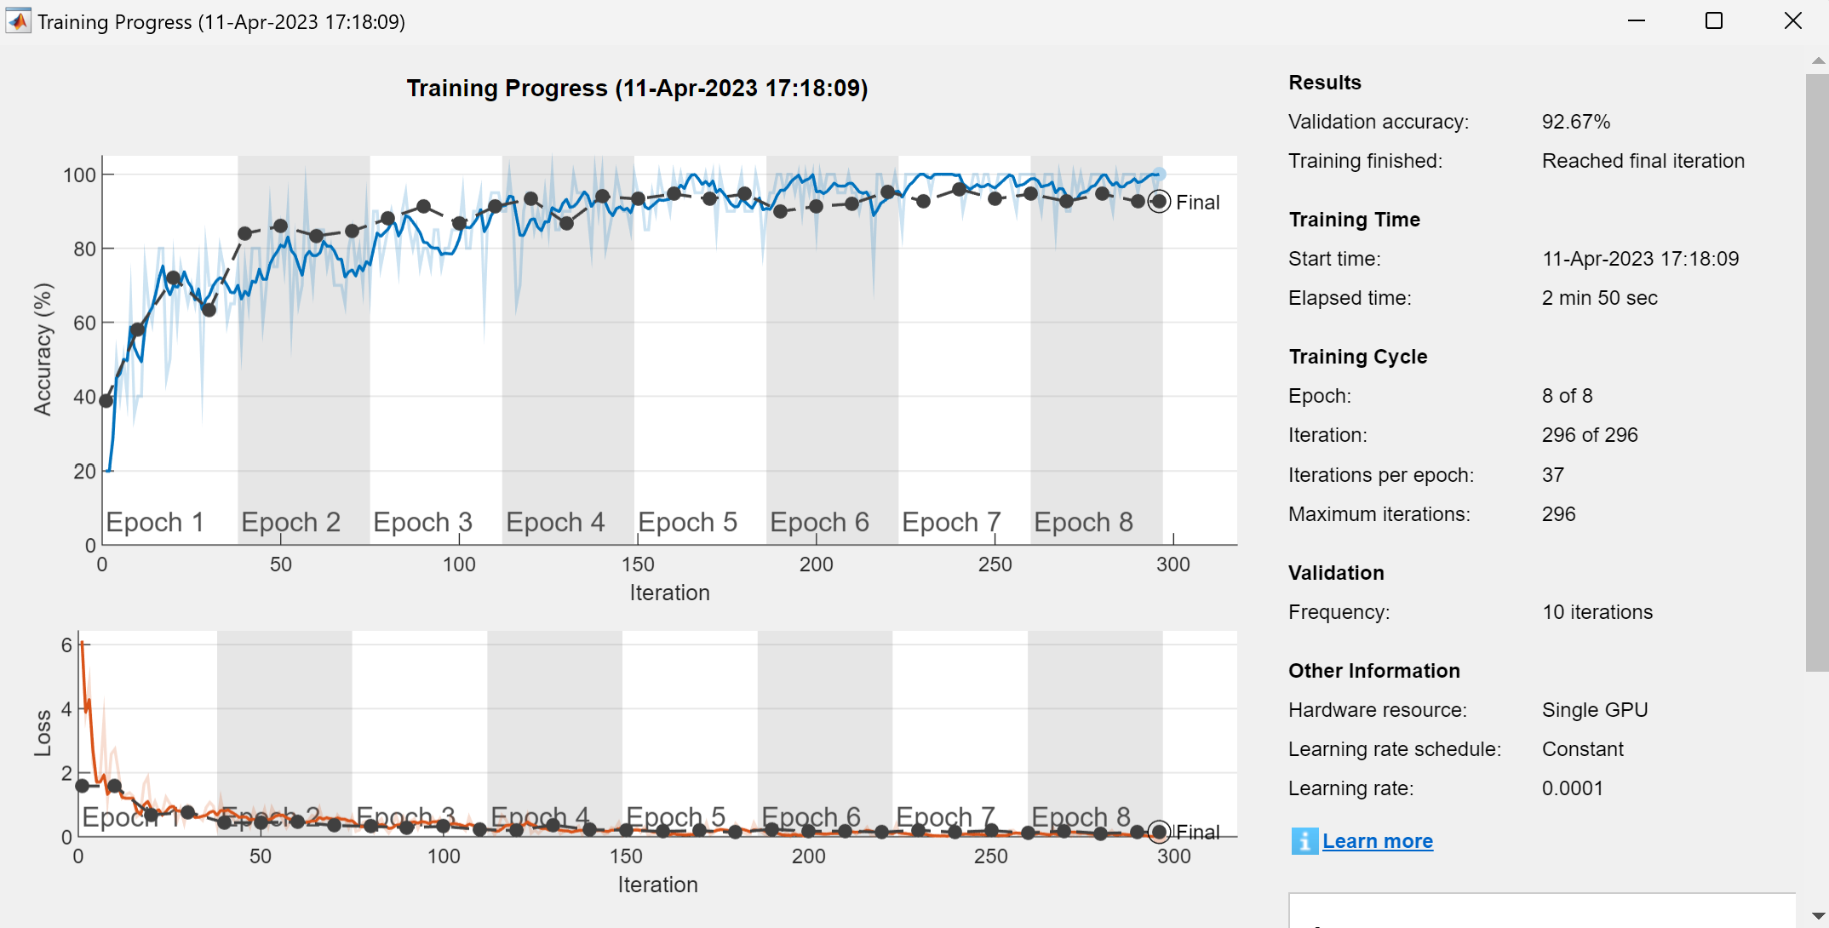

Slide 13
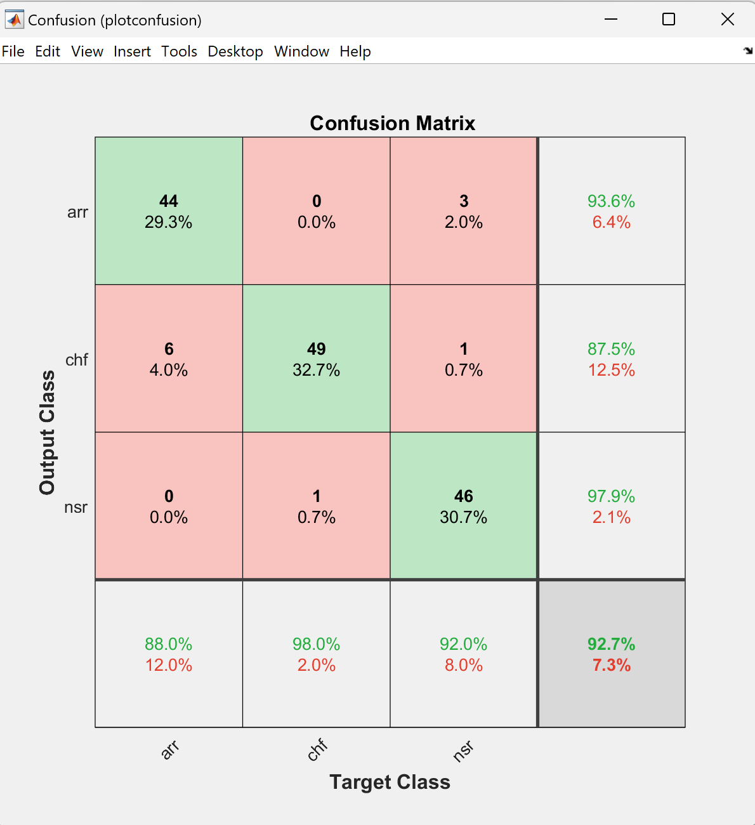

Slide 14
